Slide 1

Way forward for the Power Sector of West Bengal
Key Drivers and Imperatives
Deloitte Touche Tohmatsu India LLP, January 2022
Notes:
To be picked from https://consulting.deloitteresources.com/brand/Pages/Imagery.aspx
https://brandspace.deloitte.com/content/index/guid/image_library?search_term=&list_size=25&assettag%5B16%5D%5B%5D=43&assettag%5B19%5D%5B%5D=50

Slide 2

Contents
1
Overview of West Bengal power market and average tariff rate
2
Key Imperatives
3
Opportunity: Reduction of power purchase cost from WBPDCL
4
Opportunity: Reduction of fixed cost for WBSETCL
5
Power Purchase Portfolio optimization
6
Opportunity: Reduction of cost of supply for WBSEDCL
7
Marginal Renewables in Purchase, Capacity Addition far below Estimated Potential
8
Adopting restructured Subsidy Model for WBSEDCL
9
Benchmarking: States with high industrial energy consumption and RE energy portfolio
10
Rationalization of Tariff Structure
11
Annexure
@ 2020 Deloitte Touche Tohmatsu India LLP

Slide 3
Overview of West Bengal power market and average tariff rate

Slide 4
WBSEDCL is a key player in the West Bengal power sector
WBSEDCL is present across Generation & Distribution Segments in West Bengal
It has witnessed gradual increase in Consumers & Retail Sales
WBSEDCL’s Generation mix (MW, %) as on FY21 end
Electrification works undertaken by WBSEDCL has resulted in gradual increase in consumer strength and retail sales
The total installed capacity of WBSEDCL is 1,147 MW
The 900 MW pumped storage plant is primarily used for meeting peak as well as emergency power demand of the state
Growth in Sales (MUs)
Distribution market share in West Bengal
The electricity sales has increased at a CAGR of ~7%
Growth in Consumers (Mn)
WBSEDCL |  | CESC |  | DPL |  | IPCL |  | DVC
WBSEDCL is the largest distribution utility in West Bengal with consumer share of ~85% and sales share of 58% as per FY 2020 data set
The consumer growth has increased at a CAGR of ~6%
@ 2020 Deloitte Touche Tohmatsu India LLP
Data source: WBSEDCL’s Annual Reports

Slide 5
Industrial and domestic revenue comprises of ~70% with reducing trend in Dist. And AT&C Loss
WBSEDCL’s consumer & sales mix are dominated by low voltage domestic consumers
There has been a decreasing trend in Dist. & AT&C loss over last few years
WBSEDCL’s Consumer, Sales & Revenue Mix (FY21)
WBSEDCL’s Dist. Losses
High proportion (~90%) of low voltage domestic consumers
Domestic |  | Commercial |  | Agricultural |  | Industrial |  | Others
WBSEDCL’s AT&C Losses
Industrial consumers comprises of ~1% of total no. of consumers which contributes to ~32% of total revenue whereas ~89% of Domestic consumers comprises of ~37% of total revenue.
There has been a decreasing trend in Distribution and AT&C Losses over last few years.
Data source: WBSEDCL’s Annual Reports

Slide 6
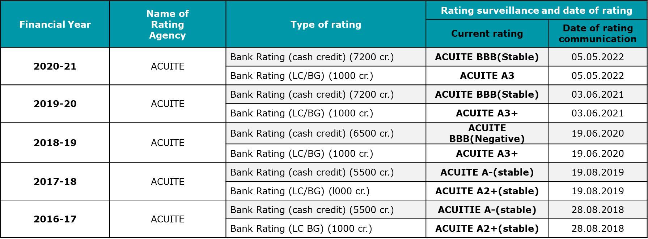
Financial Health of WBSEDCL
The figures exclude Other Comprehensive Income
Debt to Equity Ratio
There has been an increasing trend in short term borrowings which led to decline in profitability of WBSEDCL.
This resulted in a migration of credit rating from ACUITE A2+ (Stable) in FY 2016-17 to ACUITE BBB (Stable) in FY 2020-21
Debt to Equity ratio has been higher than normative ratio admissible by WBERC.
*Debt:Equity for FY 2021- (Long term Borrowings + Current portion of Long-term borrowings)/ Average Equity
Data source: Annual Report of WBSEDCL
Data source: Annual Report of WBSEDCL

Slide 7
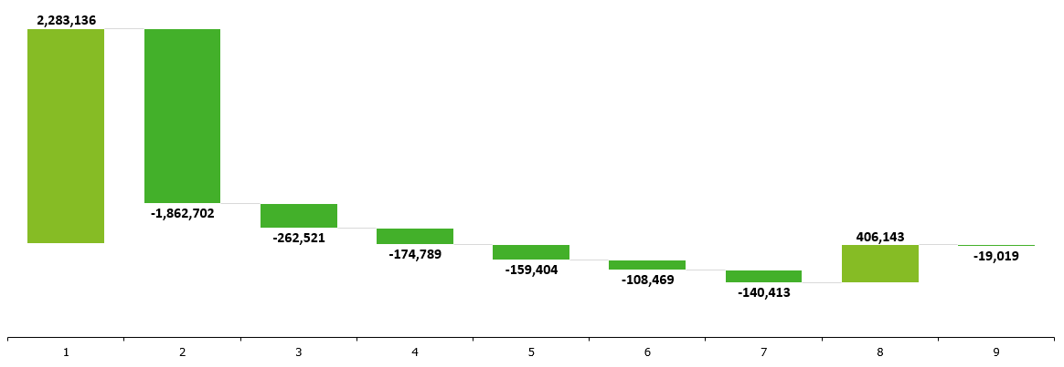
WBSEDCL Financial Cost Bridge FY 20-21
(Figures in Rs. Lakhs)
Revenue
Cost
Regulatory Asset Movement
Profit / Loss
Other Comprehensive Income: Rs. 23,825 Lakhs
(69%)
(10%)
(6%)
(6%)
(4%)
(5%)
Total Revenue | Power Purchase Cost | Transmission & System Operating Charges | Employee Benefit Expense | Finance Cost | Depreciation & Amortization | Other Expenses* | Net movement in Regulatory Deferral Account Balance | Net Profit/Loss for the period
*Other Expenses include Outsourced Jobs, R&M expense, A&G expense, other debits, expenditure on CSR.
Power Purchase and Transmission costs contribute ~80% of the total costs for WBSEDCL followed by ~Employee and Finance Costs.
@ 2020 Deloitte Touche Tohmatsu India LLP
Data Source: Financial statement of WBSEDCL for FY 2020-21

Slide 8
Regulatory process for MYT and APR petitions/orders
1. Technical Validation Session (TVS)
2. Issuance of Public Notice
3. Conduct of Public Hearing
4. Inputs towards drafting of Order
Submission of MYT ARR petition and tariff proposal before Commission along with requisite fees by November 30th.
Compliance to Tariff Regulations in terms of MYT Formats, fees etc.
Utilities publish notice in leading newspapers
Comments & suggestions from various stakeholders and public filed
Technical & Financial inputs as per prevailing Regulatory Provisions
Issuance of Final Tariff/APR Order by the Commission
Commission’s Assessment
TVS
Public Notice
Comments from Commission
Commission Scrutinizes the Petition and seek for additional information
(if any)
Utilities publish tariff proposal in their website
Utilities files their responses & replies against comments & Suggestions
Inputs from Legal as per prevailing Regulatory Provisions
The Regulatory Commission has to issue Order within 120 days of filing of the Petition by the Utilities
Utilities file Annual Performance Review (APR) Petition / True-Up Petition for previous years as per prevailing Tariff Regulation based on actual vs approved expenses by the Commission

Slide 9
Key Imperatives

Slide 10
Key Imperatives and Net estimated Benefits
1
2
3
4
5
6
Power Purchase Cost Optimization from WBPDCL
Reduction in Fixed Cost from WBSETCL
Power Purchase Portfolio Optimization for WBSEDCL
Reduction in ACOS of WBSEDCL
Structured Subsidy Model for WBSEDCL
Rationalization of Tariff Structure for WBSEDCL
Potential for reduction of fixed cost obligation and energy charges through decommissioning of older plants of WBPDCL
Reduction of cost of coal procurement through captive sources
Fixed Cost optimization by way of sustainable reduction of Return on Equity of WBSETCL
PPA cost optimization through retirement of PPAs of higher cost
Power Purchase Cost reduction through RE portfolio addition
Real time management of power surplus
ACOS options by leveraging RDSS and Grid Modernization Investments
Setting up of Anti Power Theft Police Stations
Reduction of commercial losses through restructuring of subsidy for lifeline and other domestic consumers; especially due to improvement in collection efficiency
A relook at the tariff slabs especially for Domestic, HV and LV fixed charges is required
Simplifying the existing tariff slabs may smoothen the billing process
Link to Detailed Slide
Link to Detailed Slide
Link to Detailed Slide
Link to Detailed Slide
Link to Detailed Slide
Link to Detailed Slide

Slide 11
Cost Savings Potential for WB Power Utilities
Generation (WBPDCL)
Transmission (WBSETCL)
Distribution (WBSEDCL)
Retirement Old Asset completed useful life
Coal Supply share maximum @ Captive Mine
Reduced ROE Claim by WBSETCL @ 7.5% / 10%
Billing Efficiency Improvement @ 3%- Reduction of ACOS @ retirement of contract of highest MOD plants
Billing Efficiency Improvement @ 3%
Reduction of ACOS @ Avg ECR of DVC Mejia & RTPS
Additional Savings in PP Cost
With RPO obligation if met
17 p/kWh
35 p/kWh
9 / 6 p/kWh
16 p/kWh
11 p/kWh
10 p/kWh
+
OR
+
=
+
=
+
=
52 p/kWh
61/58 p/kWh
87/79 p/kWh
Total Savings Incl. Captive+ Generation
Total Savings incl. Generation +Transmission
Total Savings incl. Generation +Transmission+ Distribution

Slide 12
Opportunity: reduction of power purchase cost from WBPDCL

Slide 13
Reduction of Fixed Cost Obligation and Energy Charge passed on to WBSEDCL through decommissioning of relatively older plant units of WBPDCL
1
Scenario I
Scenario II
Scenario I
Kolaghat (420 MW) and Bandel (120 MW ) decommissioned out of 4745 MW
Fixed Cost 145 Crores reduction ( 6%)
Energy Cost 380 Crores reduction (7%)
Balancing need for shortfall in total power purchase of WBSEDCL (~42353 MUs in FY 21)
Ramp up of Capacity from Remaining WBPDCL Units to meet earlier Generation levels
Availability of Sagardighi, Bakreswar, would need to be enhanced by at least 10 – 12%.
Revenue and ROE Levels of WBPDCL are preserved under Scenario II
INR 0.01/kWh
INR 0.02/kWh
INR 0.03/kWh
INR 0.05/kWh
INR 0.12/kWh
INR 0.17/kWh
Reduction in Fixed Charge Obligation
Reduction in Energy Charge
Reduction in Fixed Charge Obligation
Reduction in Energy Charge
Plant | Capacity (MW) | No. of Units proposed to be decommissioned
Kolaghat | 2x210 | 2 Nos.
Bandel | 2x60 | 2 Nos.
TOTAL | 540
Current contribution of WBPDCL to WBSEDCL Average Tariff | Resultant contribution of WBPDCL to WBSEDCL average tariff in Scenario I | Resultant contribution of WBPDCL to WBSEDCL average tariff in Scenario II
2.50 | 2.33 | 2.47
Further calculation details pertaining to the above case studies are provided in Annexure
Back to Home

Slide 14
Reduction of cost of coal procurement for WBPDCL by maximizing 8 MTPA additional production
1
Current Scenario
62% coal from Captive sources being sourced by WBPDCL and 38% being supplied from CIL Basket FSA
CIL Coal is nearly 74% more expensive than its captive counterpart
Captive Coal Mines of WBPDCL
# | Names of Mines | District | Grade | Current production (MTPA) | Future Plans (MTPA)
1 | Panchura North | Jharkhand (Pakur Dist.) | G9 | 10 | 15
2 | Borjor North | Bankura | G13 | 2.25 | 3
3 | Borjora Coal Mine | Birbhum | G7 | 0.36 | Will End this year
4 | Gangaramchak Bhaduria | Birbhum | G11 | 1
5 | Tara East & West | Bardhaman | G9 | - | 4
 |  |  |  | 13.61 | 22
Net possible savings (in INR Cr) | Resultant reduction in contribution of WBPDCL to WBSEDCL average tariff through this approach
1076 | INR 0.35/kWh
Note: Actual Wt. Avg Coal Price from Captive Mines for 2020-21 was ~ Rs 1982/MT and the same for CIL basket source was ~ Rs 3618/MT
Further calculation details pertaining to the above are provided in Annexure
Note: Based on FY 2019 -20 WBPDCL Tariff Order and Coal Purchase Data
Back to Home

Slide 15
Opportunity: Reduction of fixed cost for WBSETCL

Slide 16
Reduction of Fixed Cost for WBSETCL by way of sustainable reduction of ROE %; precedence already set by Rajasthan and Uttar Pradesh
2
Current Scenario
Precedence set by other States
WBSETCL currently claims 15.5% ROE as allowed by WBERC vide Tariff Regulations
Precedence in STU of lower ROE being claimed vis-à-vis SERC Regulations to lower Discom Cost Burdens as Transition Mechanism
UPPTCL claim 2% ROE – UPERC allowed levels of 14.5%
and RVPNL claim 2% ROE - RERC allowed levels of 14%
APTRANSCO and BSPTCL have ROE ~ 10-11%
Proposed Way Forward
ROE Considered | Particulars | Amount | Total Savings | Total savings in terms of WBSEDCL avg. tariff
15.5% | Admitted ROE | INR 451 Cr. | - | -
 | Admitted Income Tax | INR 79 Cr
10% | Modified ROE (@ 10%) | INR 291 Cr. | INR 188 Cr. | INR 0.06/kwh
 | Modified Income Tax (at ROE @10%) | INR 51 Cr.
7.5% | Modified ROE (@ 7.5%) | INR 218 Cr. | INR 273Cr | INR 0.09/kWh
 | Modified Income Tax (at 7.5%) | INR 38 Cr.
Adequacy of reduced ROE to sustain future equity requirement (30%) w.r.t capital investment plans
Figures in INR Crores
Note: Admitted equity base for FY 20 is INR 2909 Cr. Whereas MAT rate considered by Commission to compute income tax was 17.47% (for FY 20)
*Additional amount of ~INR 444 Cr available with WBSETCL as Cash and Bank balance for FY ‘20
Back to Home
Source: 1) Respective TRANSCO Tariff Orders

Slide 17
Power Purchase Portfolio Optimization

Slide 18
Load-Demand Curve ( In MW) of last 3 Years for WBSEDCL as per 7th MYT Order
3
FY | Minimum Demand (In MW) | Maximum Demand (In MW) | Average Demand (In MW)
FY 21 | 4100 | 5600 | 4552
FY 22 | 4000 | 6700 | 4726
FY 23 | 4150 | 6800 | 4905
FY | Minimum Demand (In MW) | Maximum Demand (In MW) | Average Demand (In MW)
FY 21 | 4100 | 6000 | 4609
FY 22 | 4350 | 6250 | 5093
FY 23 | 4700 | 6800 | 5219
FY | Minimum Demand (In MW) | Maximum Demand (In MW) | Average Demand (In MW)
FY 21 | 4000 | 4750 | 4254
FY 22 | 4250 | 5000 | 4635
FY 23 | 4400 | 5350 | 4866
Back to Home

Slide 19
Season-wise average hourly load-generation balance (in MW) for WBSEDCL for FY 2022-23
3
As per Clause No. 5.10.6 (Page No. 40) of WBSEDCL Tariff Order for 7th Control Period, Commission stated that there is considerable surplus power throughout the day even during the peak hours. The major reason is the already entered long-term PPA by WBSEDCL in recent years, when generation from WBPDCL was low due to poor availability of coal.
Back to Home

Slide 20
3
Average Margin Realized on Trading Sales
In Rs./kwh
Sl. No | Particulars | FY 2015-16 |  | FY 2016-17 |  | FY 2017-18 |  | FY 2018-19 |  | FY 2019-20 |  | FY 2020-21
 | Categories | Energy (in MU) | Per unit rate (Rs./kwh) | Sale (in MU) | Per unit rate (Rs./kwh) | Sale (in MU) | Per unit rate (Rs./kwh) | Sale (in MU) | Per unit rate (Rs./kwh) | Sale (in MU) | Per unit rate (Rs./kwh) | Sale (in MU) | Per Unit Rate (Rs./kwh)
1. | Average Energy Billing to WBSEDCL’s Own Consumers
a. | Domestic | 9,120 | 5.77 | 9,825 | 6.25 | 10,267 | 6.43 | 10,876 | 6.42 | 12,216 | 6.59 | 12,872 | 6.68
b. | Commercial | 3,462 | 7.89 | 3,744 | 8.65 | 4,034 | 8.75 | 4,269 | 8.85 | 4,752 | 8.81 | 3,978 | 8.90
c. | Industrial | 6,762 | 7.13 | 7,098 | 8.14 | 7,655 | 8.19 | 8,567 | 8.08 | 10,108 | 7.53 | 9,240 | 7.41
d. | Total | 22,991 | 6.51 | 24,290 | 7.11 | 25,527 | 7.30 | 27,678 | 7.35 | 31,109 | 7.26 | 29,556 | 7.22
2. | Power Purchase Cost and Trading Sale
a. | Sale to Person Other than Licensee and Consumer | 1,971 | 5.09 | 1,980 | 5.19 | 2,049 | 4.92 | 1,794 | 5.21 | 1,210 | 4.48 | 2,642 | 3.55
b. | Power Purchase Cost* | 36,285 | 3.40 | 37,577 | 3.50 | 38,849 | 3.70 | 39,333 | 4.06 | 39,933 | 4.23 | 42,210 | 4.40
c. | Average Margin realized (a– b) |  | 1.69 |  | 1.69 |  | 1.22 |  | 1.16 |  | 0.25 |  | (0.85)
*Power Purchase Cost excludes Transmission charges
Back to Home

Slide 21
3
Average Margin Realized on Trading Sales
In Rs./kwh
Class of Consumers based on Voltage | West Bengal |  | Jharkhand |  | Bilateral Beneficiaries |  | Total Sample Size
 | Consumer No. | Sample Size at 90% CI | Consumer No. | Sample Size at 90% CI | Consumer No. | Sample Size at 90% CI
220 KV | 3 | 3 | 2 | 2 |  |  | 5
132 KV | 23 | 17 | 16 | 13 |  |  | 30
33 KV | 85 | 38 | 163 | 48 |  |  | 86
11 KV |  |  | 34 | 23 |  |  | 23
Total | 111 | 67 | 215 | 101 | 21 | 16 | 160
*Power Purchase Cost excludes Transmission charges
Back to Home

Slide 22
Window of Opportunity for exiting High Cost PPA for WBSEDCL ( Rates are as per Issued Tariff Order of WBERC Pertaining to FY 2020-21)
3
The above analysis is in line with the MOP notification (F.No. 09/11/2021-RCM ) dated 26th May 2022 as highlighted below:
Around 58 BUs of thermal power generated by the public, state, and private sector generating stations can be substituted by 30 GW of renewable energy by the FY 26
MoP has identified 81 TPS(s) in the central, state, and private sectors to replace coal with renewable power by 2026
Generating stations that have installed or procured a higher capacity of power for the purpose of replacement but not scheduled are free to sell such power in the exchanges
Back to Home

Slide 23
Power Purchase Portfolio Management needs a Focused Optimization and Real Time Management based on Tariff Order for FY 2020-21 of 7th Control Period for WBSEDCL
3
Retirement/revision of PPAs with higher cost incidence.
Renewable Portfolio addition will progressively reduce power purchase cost burden (500 MW Solar Plant @ 25% CUF will enable avoiding energy charges payment by ~ Rs. 50 Crores annually
Simulated Estimation of savings by optimizing the Purchase Portfolio – DVC, Farakka U#1&2 & Kolaghat procurement entirely replaced with low-cost power purchases cost ( Avoidance calculated on total Cost basis )
Source | Allocation (in MW) | Approved (MU) | Utilization Factor (%) | Average Cost | Average Rate
 |  |  |  | (Crore) | ( Rs/KWh)
Kolaghat | 1139 | 1710 | 17% | 594 | 3.48
DVC | 250 | 1771 | 81% | 796 | 4.49
Farakka U#1&2 | 476 | 3546 | 85% | 1255 | 3.54
WBPDCL excl. Kolaghat | 3170 | 21943 | 79% | 6882 | 3.14
DPL | 502 | 3518 | 80% | 1352 | 3.84
NTPC excl. Farakka U#1&2 | 618 | 3680 | 68% | 1343 | 3.65
PTC -Thermal | 300 | 1242 | 47% | 578 | 4.65
HMEL | 270 | 2010 | 85% | 1040 | 5.17
PTC-Hydro | 985 | 3297 | 38% | 990 | 3.00
NHPC | 426 | 1865 | 50% | 795 | 4.26
Other |  | 5331 |  | 1909 | 3.58
Total |  | 49913 |  | 17535 | 3.51
Source | Allocation (in MW) | Approved (MU) | Utilization Factor (%) | Average Cost | Average Rate
 |  |  |  | (Crore) | ( Rs/KWh)
Kolaghat | Scenario for retirement/Surrender of PPA
DVC
Farakka U#1&2
WBPDCL excl. Kolaghat | 3170 | 23601 | 85% | 3.14 | 7402
DPL | 502 | 3738 | 85% | 3.84 | 1437
NTPC excl. Farakka U#1&2 | 618 | 4601 | 85% | 3.65 | 1680
PTC -Thermal | 300 | 2234 | 85% | 4.65 | 1039
HMEL | 270 | 2010 | 85% | 5.17 | 1040
PTC-Hydro | 985 | 4312 | 50% | 3.00 | 1295
NHPC | 426 | 1865 | 50% | 4.26 | 795
Other |  | 7552 |  | 3.58 | 2704
Total | 6270 | 49913 |  | 3.48 | 17392
As it seems from the above, if we consider the cheaper power source at its normative utilization factor, the net savings in power purchase cost is ~150 Crore (i.e., Rs. 0.03 / kwh)
Back to Home

Slide 24
Opportunity: Reduction of cost of supply
WBSEDCL

Slide 25
Existing status of Billing Efficiency
4
Sl. No. | Zone | <15% | 15%-30% | 30%-45% | >45% | Grand Total
1 | Berhampur |  | 7 | 4 | 1 | 12
2 | Burdwan | 4 | 6 | 5 | 1 | 16
3 | Kolkata | 8 | 5 | 1 | 6 | 20
4 | Medinipur | 1 | 5 | 6 | 2 | 14
5 | Siliguri | 3 | 6 | 5 | 1 | 15
Grand Total |  | 16 | 29 | 21 | 11 | 77
Sl. No. | Zone | Name of Division | Billing Efficiency | Collection Efficiency | AT&C Loss %
1 | Berhampur | Kandi | 52.28% | 89.45% | 53.23%
2 | Burdwan | Rampurhat | 58.47% | 92.37% | 45.99%
3 | Kolkata | Bhangar | 55.73% | 92.17% | 48.64%
4 |  | Diamond Harbour | 57.21% | 96.00% | 45.08%
5 |  | Kankdwip | 51.32% | 92.62% | 52.47%
6 |  | Baruipur | 54.68% | 93.07% | 49.10%
7 |  | Jaynagar
8 |  | Canning | 35.20% | 79.98% | 71.85%
9 | Medinipur | Khatra | 60.48% | 79.22% | 52.09%
10 |  | Egra | 56.97% | 94.96% | 45.90%
11 | Siliguri | Dinhata | 66.18% | 81.30% | 46.20%
Back to Home

Slide 26
Significant Cost Reduction can be achieved by Commercial Losses Reduction (1/2)
4
Leveraging of RDSS Investments in a targeted manner complemented with IT OT initiatives are critical
Targeted Program on Metering Efficacy for Billing complemented with other initiatives for specific pockets
Reduction of Cost of Supply after considering Average variable cost of DVC ** Plant (as per tariff petition for FY 2020-21)
Improvement in Billing Efficiency vis a vis AT&C Losses
Requirement of input energy would go down
Reduction of Cost of Supply after retirement of contract of highest merit order plants
RDSS
Grid Modernization
IT/OT System
** Based on approved average power purchase rate of DVC Plant – Mejia and RTPS
Back to Home

Slide 27
Significant Cost Reduction can be achieved by Commercial Losses Reduction (2/2)
4
Reduction of Cost of Supply after considering Average variable cost of DVC ** Plant ( as per tariff petition for FY 2020-21)
Particulars |  | Billing Efficiency | Energy Sold (MU) | Net Input Energy (MU) | Net Energy Reduction (MU) | Energy Charge | Net Saving | Saving in Per Unit
 |  | (%) |  |  |  | ( Rs /KWh) | ( Crore) | (Rs/KWh)
Actual Parameter |  | 79% | 29556 | 37361 | 0 | 2.89 | 0
Phase Wise Reduction
Phase Wise Loss Reduction Planning | Phase 1 | 82% | 29556 | 36044 | 1317 |  | 380 | 0.11
 | Phase 2 | 85% | 29556 | 34772 | 1272 |  | 367 | 0.11
 |  | 88% | 29556 | 33510 | 1262 |  | 364 | 0.11
 |  | 91% | 29556 | 32319 | 1191 |  | 344 | 0.11
 |  | 95% | 29556 | 31112 | 1208 |  | 349 | 0.11
Reduction of Cost of Supply after retirement of contract of highest merit order plants
Particulars |  | Billing Efficiency | Energy Sold (MU) | Net Input Energy (MU) | Net Energy Reduction (MU) | Energy Charge | Net Saving | Saving in Per Unit
 |  | (%) |  |  |  | ( Rs /KWh) | ( Crore) | (Rs/KWh)
Actual Parameter |  | 79% | 29556 | 37361 | 0 | 4.49 | 0
Phase Wise Reduction
Phase Wise Loss Reduction Planning | Phase 1 | 82% | 29556 | 36044 | 1317 |  | 592 | 0.16
 | Phase 2 | 85% | 29556 | 34772 | 1272 |  | 572 | 0.16
 |  | 88% | 29556 | 33586 | 1185 |  | 533 | 0.16
 |  | 91% | 29556 | 32443 | 1143 |  | 514 | 0.16
 |  | 94% | 29556 | 31309 | 1134 |  | 510 | 0.16
** Based on approved average power purchase rate of DVC Plant – Mejia and RTPS
Source : Tariff Order for 7th Control Period of WBSEDCL.
Back to Home

Slide 28
Reduction in bulk power purchase cost through fulfilling RPO obligation target (for FY 21)
Inputs:
Particulars | Value | Unit
Total Power purchase cost | 1,862,702 | Rs Lakhs
Total Power Purchase in MUs | 42,352.86 | MUs
Requisite MUs to fulfil Total RPO | 3173.72 | MUs
Resultant savings on influx and swapping with RE to the extent of quantum for which RPO is unfulfilled for FY 21
Particulars | Value | Unit
Actual Average Power Purchase Cost for FY 21 | 439.80 | Paisa/Unit
Average power purchase cost through swapping with RE (considered at Rs 3/unit) to the extent of quantum of RPO non-fulfilment | 429.33 | Paisa/unit
Total Savings | 10.48 | Paisa/unit

Slide 29
Concept of Anti Power Theft Police Stations
4
Anti Power theft police stations play a crucial role in the prevention of power thefts and minimization of AT&C losses.
Setting up of anti power theft stations got conceptualized with the fact that regular police stations are overloaded with other general cases and the electricity theft issues need immediate resolution.
Anti power theft police stations enhance quality of investigation in the power theft crimes. These stations can register and investigate cases only under sections 135, 138, 139, 140, 141 and 150 of the Electricity Act 2003¹.
KEY BENEFITS
Indian states with anti power theft police stations (Non-exhaustive list)
Uttar Pradesh
Odisha
Speedy investigations and prompt follow up- Dedicated personnel working exclusively on power theft cases quickly address the problems of power theft.
Gujarat
Rajasthan
Ease of Registering Reports – Dedicated police stations help enforcement wings of the Discoms to get the FIRs registered promptly.
Punjab
Maharashtra
Telangana
Madhya Pradesh*
Single Source of Data – Single point of registration and investigation is a valuable source of data to the Discoms to identify pattern and nature of power thefts, high theft prone areas at district/zone level.
Implementation Model of select States
Telangana -
Full-fledged anti-power theft police station approved in Siddpet town
Creation of 148 posts for police personnel in Telangana State Power Generation Corporation Limited (TSGenco)³ also granted
Gujarat –
16 dedicated GUVNL Police stations created for lodging power thefts FIR & complaints⁴.
Additional Director General (Security), GUVNL supervises these special police stations⁵ to ensure seamless functioning and coordination with the state government
Improved Billing & Collection Efficiency – Reduction in theft cases leads to enhanced billing and collections.
1. Impact Analysis of Anti Power theft police stations
3. Deccan Chronicle
4. GUVNL Website
5. Times of India
* To be implemented soon - TOI
Back to Home

Slide 30
Marginal Renewables in Purchase, Capacity Addition far below Estimated Potential

Slide 31

RPO Achievement 2021-22
RPO Target for 2021-22: 21.18%
All India RPO achievement (Provisional): ~15.1% ( 191Billion units)
National Target : 21.18%

Slide 32
States | Sanctioned (MW) | Status of Implementation
Rajasthan | 1200 | Commissioned 27.5MW Plants. 440 PPA signed so far. 40 Projects for 55MW under installation
Himachal Pradesh | 30 | Commissioned 15.25MW Plants.
Gujarat | 500 | State Government approval pending
Karnataka | 500 | Capacity surrendered by State
Maharashtra | 500 | LOA issued for 54.75MW. New tender 431MW floated (3rd June last date)
Odisha | 500 | LOA issued to 5 developers for 12.75MW. Tariff is proposed to be revised. EOI to be re-floated for remaining capacity
Telangana | 500 | No Progress. Approval awaited from State
Madhya Pradesh | 500 | LOA issued for 295.58 MW - PPA executed for 35 MW
Uttar Pradesh | 225 | PPA signed for 8 MW
Punjab | 220 | 3 bids for 1 MW each – Allotment in process. Tariff to be revised
Tamil Nadu | 424 | LOA issued for 3MW
Haryana | 65 | PPA signed for 8.57MW by DHBVN and 2MW by UHBVN. EOI for remaining capacity to be floated
Delhi | 0 | Capacity withdrawn
Assam | 50 | List of substations, EOI, Model PPA approved by BoD
Goa | 50 | 22 Bids received for 40MW has been sent to DISCOMs for assessment. Feasibility Report awaited from Electricity Department
Jharkhand | 50 | Tender in pilot mode for 1 MW capacity
Kerala | 40 | Bids invited for 10 MW
Chhattisgarh | 30 | 22 applications for 29.1MW received
Puducherry | 7 | No progress reported
Jammu & Kashmir | 5 | 6 bidders have been identified for 15.4 MW capacity. Tariff of Rs. 4.79 has been discovered through bidding.
Meghalaya | 5 | State proposes to implement through EESL. No progress reported
Tripura | 5 | Applications received for 4 MW capacity
COMPONENT A PROGRESS SO FAR
Front runner States
States speeding up

Slide 33
Sr. No. | States | Capacity Allotted (MW) | Capacity Installed (MW)
1 | Gujarat | 1937 | 1143.7
2 | Rajasthan | 100 | 36.46
3 | Uttar Pradesh | 98 | 23.68
4 | Haryana | 51.5 | 22.36
5 | Telangana | 72.295 | 21.44
6 | Kerala | 250.9 | 19.96
7 | Madhya Pradesh | 58 | 18.19
8 | Chandigarh | 35 | 17.36
9 | Punjab | 80.213 | 14.31
10 | Uttarakhand | 22 | 9.15
11 | NCT of Delhi | 36 | 2.59
12 | Maharashtra | 133.5 | 2.29
13 | Goa | 20 | 1.96
14 | Bihar | 25 | 1.93
15 | Chhattisgarh | 16 | 0.95
16 | Jharkhand | 11.375 | 0.88
17 | Himachal Pradesh | 15 | 0.78
18 | Andhra Pradesh | 8 | 0.56
19 | Assam | 3.5 | 0.2
20 | Mizoram | 1.5 | 0.19
21 | Manipur | 1 | 0.18
22 | Puducherry | 5 | 0.006
23 | Odisha | 20 | 0
24 | Karnataka | 40 | 0
25 | Meghalaya | 20 | 0
26 | Tamil Nadu | 10 | 0
27 | West Bengal | 60 | 0
28 | Jammu & Kashmir | 20 | 0
29 | Lakshadweep | 0 | 0
30 | Nagaland | 3.8 | 0
31 | Sikkim | 2 | 0
32 | Andaman & Nicobar | 1 | 0
33 | Tripura | 1 | 0
RTS Progress Status
Significant Progress
Slow Progress
No Progress

Slide 34
COMPONENT C PROGRESS - INDIVIDUAL PUMP SOLARIZATION
Sr. No. | State | Sanctioned (IPS) | Achievement
1 | Assam | 603 | No progress has been reported
2 | Gujarat | 7000 | Work allocated under IPS.
3 | Jharkhand | 208 | Initially sanctioned in FY 2019-20. No progress report. Capacity cancelled and resanctioned recently
4 | Kerala | 9448 | 38 Work Orders issued. 14 Pumps installed under IPS. Other installations are on-going
5 | Punjab | 39 | Sanctioned recently
6 | Rajasthan | 10764 | 1026 pumps have been solarised
7 | Tamil Nadu | 20000 | No progress reported even after revalidation of sanction in FY 2021-22
8 | Tripura | 2600 | Tender for selection of vendors under finalization.
9 | Uttarakhand | 200 | Tariff for Rs. 3.48/unit has been declared.
10 | West Bengal | 5478 | Work awarded for 700 pumps under IPS. Balance have been sanctioned recently.

Slide 35
Renewable integration has historically been low in West Bengal; significant scope for improvement in this area that may help to reduce high-priced short term power purchase by WBSEDCL
With respect to Renewable Purchase Obligation (RPO), total RPO figures have drastically reduced in comparison to previous years, although target has increased
Decrease in actual RPO can be because Total RE purchase has decreased from 890.55 MUs in FY 2019-20 to 384.37 MUs in FY 2020-21 (reduction by ~57%)
Largest share of RE potential in West Bengal comes from Solar (6.26 GW) out of which only 0.17 GW solar capacity has been installed as on January 2022 (Less than 3%)
*Note: Estimated actual RPO figures calculated from WBSEDCL Annual Report 2020-21
Source: RE potential data from MNRE’s Akshay Urja Portal
Source: 1) Actual RPO details from respective APR Application 2) Target RPO figures from WBERC 3)RE potential data from MNRE’s Akshay Urja Portal 4) Actual installed capacity as on January 2022 from MNRE

Slide 36
Significant opportunity for further RE capacity addition in West Bengal
Details of Upcoming RE Projects for WBPDCL
Type of Project | Project Name
Solar Project | Floating Solar, BkTPP (1x500 MW)
 | Floating solar stg-2 & 3 SgTPP ( 1x10 MW & 1x5 MW) Floating Solar, STPS (1x 7.5 MW & 1x5 MW) Ground Solar , STPS ( 1x20 MW)
Island Solar Project | Nayachar Solar Project ( 1200 MWp)
Dam Project | 1200 MW Kangsabati Project 270 MW Teesta Project 155 MW Tilpara Project
Figures in MW
Details of Upcoming RE Projects for WBSEDCL
REW | Project Details
Solar Ground Mounted | 2 X 10 MW Ground Mounted Project at Gangapur, Block-Rajnagar, Birbhum
 | 125 MW Goaltore Solar Park Project Phase-II
Roof Top Solar | 10 MW Rooftop Solar Power Project across West Bengal (Domestic)
Agri Solar | Solarisation of 700 No Agricultural Pump Under Kusum – C Burdwan & Hooghly (5 MWp) Solarisation of 23000 No Agricultural Pump Under Kusum – C
Floating Solar | PPSP 10 MW Floating Solar Project, (Upper Dam)Barria Mouja, Ajodhya Hills, Dist –Purulia
PPSP | 1000 MW Kulbera 1000 MW Katlajaal
As per Clause No. 5.10.4 (Page No. 38) of WBSEDCL Tariff Order for 7th Control Period, Commission stated that except for solar RPO target for 2020 — 21 , WBSEDCL has yet to fulfil the solar and non-solar RPO targets during the seventh control period. In this respect WBSEDCL is directed to tie up with renewable sources through long-term PPAs instead of relying on the short-term market.
Source: 1) Solar portfolio of WBSEDCL taken from Annual report 2020-21 2) Solar portfolio data of WBPDCL and DPL from respective utilities and their website 3) Small HEP portfolio data taken from WBSEDDCL Annual report 2020-21

Slide 37
Adopting restructured Subsidy Model for WBSEDCL

Slide 38
Introduction on Govt. of West Bengal Electricity Tariff Subsidy
5
As per order of Govt. of West Bengal, State Govt. subsidy for electricity consumption is provided to the following consumer category through their energy bills.
The amount payable by consumer is determined after deducting the eligible amount of Govt. subsidy from Gross bill amount of respective consumers (Based on Tariff approved by WBERC & consumption slab)
Presently Domestic consumers are under Quarterly billing system and agriculture consumers are monthly billing system. Govt. subsidy is extended to only following consumer category ( Details set along side)
.
Life Line (Domestic) Consumer (means Domestic consumers having contract demand upto 0.3 KW and quarterly consumption of electricity upto 75 units or monthly consumption upto 25 units) : Govt. subsidy is provided against entire energy bill including meter rent (i.e Zero Bill)
[In any quarter, if consumption > 75 unit, then treated as Domestic (Rural / Urban)]
Domestic (Rural/Urban) Consumer : Domestic consumer having monthly consumption of electricity upto 300 units has been provided Govt subsidy on energy Charge (slabwise), Fixed Charge & MVCA.
[In any quarter, if consumption > 900 unit, no govt. subsidy is provided)]
Agriculture Consumer: Agriculture consumer having monthly consumption of electricity upto 300 units has been provided Govt subsidy on energy Charge, Fixed Charge & MVCA
[In any month, if consumption > 300 unit, no govt. subsidy is provided)]
Back to Home

Slide 39
5
Subsidy Outlay– Consumer Category wise
The following table highlights the subsidy amount outlay by Govt. West Bengal for the WBSEDCL consumers
Govt Subsidy Outlay during 2020-21
Category of Consumer | No of distinct consumer availed Govt. subsidy (In Lakhs) | Amount of Govt Subsidy (Rs Crore)
Domestic | 110 | 1088.97
Agriculture | 3 | 24.96
Life line Domestic | 72 | 260.10
Total | 185 | 1374.03
Govt Subsidy Outlay during Last 2 Years
Particulars ( All Figures are in Rs Crores) | FY 20-21 | FY 21-22
Govt Subsidy Claimed & Received | 1374.03 | 1530.53
Subsidy Received by WBSEDCL consumers other than Hasir alo(lifeline) | 1113.93 | 1206.82
Subsidy Received by WBSEDCL consumers Hasir alo(lifeline) | 260.10 | 323.71
Back to Home

Slide 40
Tariff Subsidy Scenarios for WBSEDCL
5
Scenario 1
(existing)
Scenario 2
Scenario 3
Scenario 4
Scenario 5
Scenario 6
lifeline and domestic consumers monthly consumption.*
Up to 25 kwh | Up to 50 kwh | Up to 75 kwh | Up to 25 kwh | Up to 50 kwh | Up to 75 kwh
Up to 300 kwh | Up to 300 kwh | Up to 300 kwh | Up to 200 kwh | Up to 200 kwh | Up to 200 kwh
Other domestic consumers monthly consn.
AT&C Loss
Figures in Rs. Crore.
Please refer to Annexure-2 for current subsidy Details
AT & C Loss Reduction**
*Lifeline and Domestic consumers, other domestic consumers and agricultural consumers monthly consumption has been calculated using the projections of FY 2020-21 and FY 2021-22 MYT Petition.
**For computation of AT& C Loss reduction for FY 2020-21 & FY 2021-22, the base figures have been considered based on Annual account of FY 2020-21.

Slide 41
Benchmarking: States with high industrial energy consumption and RE energy portfolio

Slide 42
Gujarat : Analysis of Power Portfolio from different sector and tariff rate comparison for different category of consumer
Around 31% of renewable portfolio
Average Power Purchase Cost is Rs. 3.5 / KWh
Average energy sale to Industrial consumer is nearly 41% in MUs and 55% in Revenue.
Average Applicable tariff to Industrial consumer is Rs. 5.58 / KWh
Power Purchase (In MUs) Vs Average Power Purchase Cost ( Rs. / KWh)
110299 MU
Sector wise Installed Capacity (In MW)
Comparison of Average Tariff Rate of Different Category of Consumer
36676 Cr
87170 MU
Total Capacity : 28229 MW
Source : Tariff Order for FY 2021-22 and https://www.gercin.org/wp-content/uploads/2020/09/Statistical-.pdf

Slide 43
Andhra Pradesh: Analysis of Power Portfolio from different sector and tariff rate comparison for different category of consumer
Around 36% of renewable portfolio
Average Power Purchase Rate is Rs. 3.88 / KWh
Average energy sale to Industrial consumer is nearly 26% in MUs and 39% in Revenue.
Average Applicable tariff to Industrial consumer is Rs. 7.5 / KWh
Total Power Purchase (In MUs) Vs Average Power Purchase Cost ( Rs. / KWh)
67756 MU
Sector wise Installed Capacity (In MW)
Comparison of Average Tariff Rate of Different Category of Consumer
31164 Cr
60944 MU
Total Capacity : 25712 MW
Source : Tariff Order for FY 2021-22 and CEA Report on Installed Capacity

Slide 44
Rationalization of Tariff Structure

Slide 45
6
Comparison of Industrial tariff Rate vs average tariff rate of different states
Industry Intensive state like Gujarat, Andhra Pradesh have lower Industrial Tariff.
Average tariff rate for 11 KV Industrial Consumer and Average Billing Rate ( At Load Factor 40%)
Average tariff rate for 33 KV Industrial Consumer and Average Billing Rate (Load Factor of 40%)
** Average Tariff rate includes fixed charge, variable charges and electricity duty
Source : https://cea.nic.in/wp-content/uploads/2021/03/tariff_2019.pdf , ERC Order of different states and Annual report of WBSEDCL , pg 191 of 225 (250kW large industry 40% LF)
Back to Home

Slide 46
Domestic LV Fixed charges for West Bengal is much lesser as compared to other states
6
Back to Home

Slide 47
Domestic HV Fixed Charge Comparison
6
As can be seen from above, Domestic Fixed charges for HV connections for West Bengal are considerably lower compared to other states
Back to Home

Slide 48
Potential for WBSEDCL to increase revenue in DVC command area in West Bengal
Consumer No. and sales for DVC
 | 33 kV | 132 kV
No. of Consumers | 90-120 | 10-15
Sales (MUs) | 4000-4500 | 450-550
Comparative Tariff Schedule For HT-industry Category In DVC Command Area
 |  | BASE RATE : ENERGY CHARGE (IN PAISE/KWH)
Consumer Category |  | WBSEDCL (Notification 16-11-19) |  |  | DVC (Tariff Order dtd 05-05-22) |  |  | DPL (Tariff Order dtd 28-03-22)
 | TOD slab | Summer | Monsoon | Winter | Summer | Monsoon | Winter | Summer | Monsoon | Winter
HT-Industry (33 KV) | Normal | 424 | 422 | 420 | 459 | 457 | 455 | 422 | 420 | 418
 | Peak | 508 | 506 | 503 | 550 | 548 | 545 | 496 | 494 | 491
 | Off-peak | 361 | 359 | 358 | 391 | 388 | 388 | 359 | 357 | 355
HT-Industry (132 KV) | Normal | 409 | 407 | 405 | 444 | 442 | 440 | 417 | 415 | 412
 | Peak | 491 | 488 | 486 | 533 | 530 | 528 | 490 | 488 | 484
 | Off-peak | 348 | 346 | 344 | 377 | 376 | 374 | 354 | 353 | 350
 | DEMAND CHARGE (IN RS/KVA/MONTH)
 | WBSEDCL (Notifications ) | DVC (Tariff Order dtd 05-05-22) | DPL (Tariff Order dtd 28-03-22)
All the aforesaid categories | 384 | 384 | 320
Significant potential for improving sales mix and high value consumers for WBSEDCL

Slide 49
WBSEDCL: Historically there has been significant delay in issuance of Tariff/APR/FPPCA Orders and release of admitted APR/FPPCA amounts; APR/FPPCA orders from FY 19 onwards have not been issued
Notional date for Order issuance
Actual Order issuance date
APR/FPPCA amount release date
Tariff Order
Delay (in days)
Avg. delay in Tariff order issuance: 512 days
Delay in release of admitted amount: 3284 days
Delay: 2922 days
Delay: 2554 days
Delay: 2188 days
APR Order
APR and FPPCA Orders from FY 19 onwards have not been issued
Delay: 1823 days
Delay: 1458 days
Delay: 1093 days
Delay in release of admitted amount: 3284 days
Avg. delay in APR and FPPCA order issuance: 1252 days
Delay: 2922 days
Delay: 2554 days
FPPCA Order
Delay: 2188 days
Delay: 1823 days
Delay: 1458 days
Delay: 1093 days
Apr ‘11
Apr ‘12
Apr ‘13
Apr ‘14
Apr ‘15
Apr ‘16
Apr ‘17
Apr ‘18
Apr ‘19
Apr ‘20
Apr ‘21
Apr ‘22
Apr ‘23
Source: WBERC Tariff, APR and FPPCA Orders for WBSEDCL

Slide 50
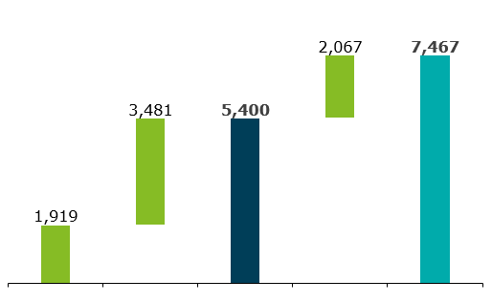
Delayed release of admitted APR/FCA/FPPCA amounts has resulted in carrying cost burden; Rs. 126.37 Cr (WBSEDCL) yet to be released
Order | Admitted Amount (Rs. Cr.) | Delay in release (days) | Carrying Cost (Rs. Cr.)
FY 12 APR Review | 2.84 | 3284 | 3.60
FY 13 APR + Review | 1,997.31 | 338 – 2922 | 735.64
FY 14 APR | 2,517.03 | 2297 – 2554 | 2,316.73
 | 64.54 | Not yet released | 62.96
FY 15 APR | 92.95 | Not yet released | 76.86
FY 16 & FY 17 APR | 2,359.64 | Not yet released | 1,507.71
FY 18 APR | 509.29 | Not yet released | 203.94
 | 61.83 | Not yet released | 24.83
Total |  |  | 4,932.27
Claims of WBSEDCL for pending APR and FPPCA Orders (Rs. Cr.) – status as on 31.03.2022
FY19
FY20
Total Claim
Carrying Cost
Grand Total
Note: Carrying costs have been computed on simple interest basis; SBI PLRs as on the 1st April of the preceding years have been considered as interest rates as per WBERC Tariff Regulations; Carrying costs have been computed till 31.03.2022; For unreleased amounts, carrying costs have been computed till 31.03.2022

Slide 51

Deloitte refers to one or more of Deloitte Touche Tohmatsu Limited, a UK private company limited by guarantee (“DTTL”), its network of member firms, and their related entities. DTTL and each of its member firms are legally separate and independent entities. DTTL (also referred to as “Deloitte Global”) does not provide services to clients. Please see www.deloitte.com/about for a more detailed description of DTTL and its member firms.
This material has been prepared by Deloitte Touche Tohmatsu India LLP (“DTTILLP”), a member of Deloitte Touche Tohmatsu Limited, on a specific request from you and contains proprietary and confidential information. This material may contain information sourced from publicly issued information or other third party sources. DTTILLP does not independently verify any such sources and is not responsible for any loss whatsoever caused due to reliance placed on information sourced from such sources. The information contained in this material is intended solely for you. Any disclosure, copying or further distribution of this material or its contents is strictly prohibited.
Nothing in this material creates any contractual relationship between DTTILLP and you. Any mutually binding legal obligationsorrights may only be created between you and DTTILLP upon execution of a legally binding contract. By using this material and any information contained in it, the user accepts this entire notice and terms of use.
©2022 Deloitte Touche Tohmatsu India LLP. Member of Deloitte Touche Tohmatsu Limited
Deloitte Touche Tohmatsu India Private Limited (U74140MH199 5PTC093339), a private company limited by shares, was converted into Deloitte Touche Tohmatsu India LLP, a limited liability partnership (LLP Identification No. AAE-8458),with effect from October 1, 2015.

Slide 52
Annexures

Slide 53
Accumulation of Regulatory Assets and existing loan burdens

Slide 54
Delay in issuance of Tariff orders and long-pending APR/FPPCA orders have led to accumulation of Regulatory Assets and Working Capital loan burden
Delay (in days) in tariff order issuance
Status of APR / FCA / FPPCA order issuance
For WBPDCL and DPL, no APR / FCA orders issued from FY 15 onwards
For WBSETCL, no APR orders issued from FY 16 onwards
For WBSEDCL, no APR / FPPCA orders issued from FY 19 onwards
Movement of Regulatory Assets and Interest on Working Capital Loans as per Annual Reports of WBSEDCL
Regulatory asset (Rs. Cr.)
Interest on Working Capital Loan (Rs. Cr.)
Data source: WBERC Tariff/APR/FCA/FPPCA Orders; WBERC website; Utility Annual Reports

Slide 55
Open Access

Slide 56
Cost structure for power purchase through Open Access
Generator
Transmission network
Distribution network
Buyer
Trader / PXs
Generation cost
System Operation charges
Cross Subsidy Surcharge (CSS)
*
#
Landed cost
Trader margin / PX charges
Transmission losses & charges
Wheeling losses & charges
Landed cost = Power purchase cost + System Operation charges + Transmission losses & charges + Trader margin / PX charges + Wheeling losses & charges + CSS + Other applicable charges
Other applicable charges may include Meter charges, NOC charges, Renewal charges, Additional surcharge, UI charges, Electricity Duty, Banking charges, etc.
*
Not applicable for procurement through Captive route / Group captive route
#
Charges will depend on voltage level of connectivity of both generator & Buyer and state-level regulations

Slide 57
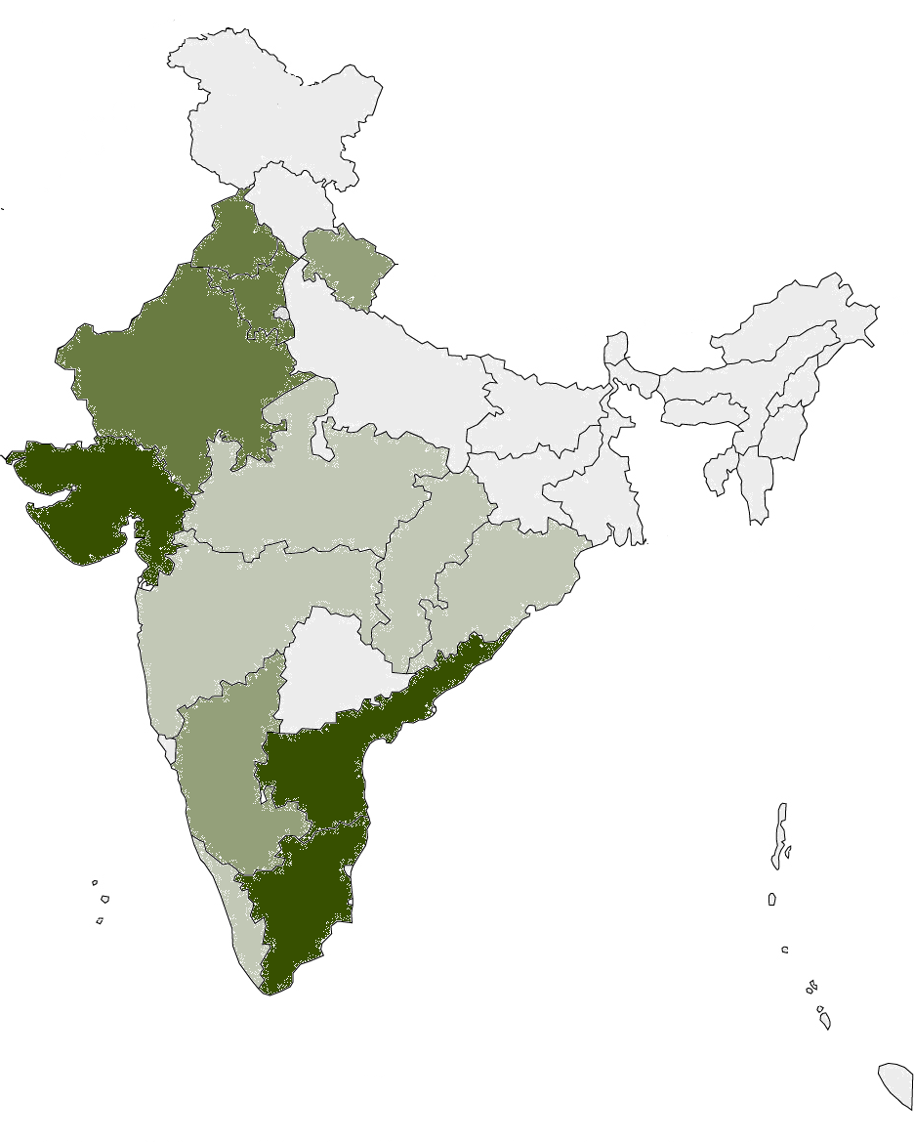
State wise snapshot of Open Access consumers
State-wise number of OA consumers sourcing power through PXs as on Mar 31, 2016
States like AP, Tamil Nadu and Gujarat have the highest concentration of OA consumers, followed by Rajasthan, Punjab and Haryana.
Apart from Power Exchanges, OA consumers also source power from –
Generator
Trader
Captive power plants
Legend
No of OA consumers | Colour code
Above 500
300 to 500
100 to 300
20 to 100
Below 20
Source: CERC Report on Short-term Power Market in India, 2015-16

Slide 58
Annexure

Slide 59
Annexure-I
State Signed PPA’s
Constituent | Station | Share in MW | Rate (Apr-Dec) 2019
WBSEDCL HYDEL | RHP (Rammam) | 51
 | JHP (Jaldhaka) | 44
 | TCF (Teesta Canal) | 68
 | Massanjore Hydel Project | 4
 | Rinchington Hydel Project | 2
 | Little Rangit Hydel Project | 2
 | Mungpoo Kalikhola hydel project | 3
 | Sidrapong Hydel Project | 0.33
 | Fazi Hydel project | 1.1
 | PPSP | 900
 | Total | 1075
WBSEDCL | TCF Solar | 20
 | Salboni solar | 10
 | Patni solar | 10
 | Mejia Solar | 10
 | Chharrah solar | 10
 | Total | 60
WBPDCL | BTPS (bandel) | 335 | 4.74
 | STPS (Santaldih) | 500 | 4.12
 | KTPP (Kolaghat) | 1260 | 4.74
 | BkTPP (Bakreshwar) | 1050 | 3.8/3.88
 | SgTPP (Sagardighi) | 1600 | 4.68/4.78
 | DPL | 550 | 4.07
 | Total | 5295
@ 2020 Deloitte Touche Tohmatsu India LLP

Slide 60
State Signed PPAs
Constituent | Station | Share in MW | Rate (Apr-Dec) 2019
ISGS Share | Farakka-I&II | 511 | 3.37
 | Farakka-III | 188 | 4.11
 | Talcher Stage-I | 92 | 3.03
 | MTPS-II (Kanti Muzzafarpur) | 38 | 6.39
 | KHSTPP-I (Kahalgaon) | 51 | 3.22
 | Tala | 390 | 2.13
 | Chukha | 86 | 2.37
 | Mandechu | 231 | 4.19
 | Teesta | 122 | 2.22
 | Rangeet | 17 | 3.69
 | Kuruchu | 30 | 2.17
 | TLDP 3 | 132 | 6.31
 | TLDP 4 | 160 | 2.68
 | DVC Mejia Unit V | 50 | 5.14
 | Total | 2098
Bundle Power | Solar | 50 | 10.71
 | Farakka Stage I&II | 15 | 3.37
 | Farakka stage III | 5 | 4.11
 | Kahalgaon stage I | 8 | 3.22
 | Kahalgaon stage II | 14 | 3.22
 | Talcher stage I | 9 | 3.03
 | Thermal total | 51
 | Total | 101
Constituent | Station | Share in MW | Rate (Apr-Dec) 2019
@ 2020 Deloitte Touche Tohmatsu India LLP

Slide 61
State Signed PPAs
Constituent | Station | Share in MW | Rate (Apr-Dec) 2019
From outside merchant capacity | Baghlier | 100 | 3.67
 | Adhunik Power | 100 | 3.09
 | MPL | 283 | 4.81
 | DVC Raghunathpur | 204 | 4.86
 | Dagachhu | 126 | 3.67
 | GoHP | 235 | 3.88
 | Stressed Asset | 200 | 4.24
 | SIPL Solar | 5 | 11.52
 | Total | 1253
Radial Power | CESC |  | 6.53
 | DVC |  | 4.51
 | APDCL-Assam for Jhaukuthi |  | 9.27
 | JBVNL-Jharkhand |  | 9.27
 | Sikkim |  | 6.6
@ 2020 Deloitte Touche Tohmatsu India LLP

Slide 62
List of solar power projects for WBSEDCL (1/2)
# | Name of the Project | Present Status | Total Capacity (MW) | Generation (MU) | CUF (%)
Commissioned
1 | 2.4 MW Grid Connected Solar Schools Rooftop Programme | Project Completed. | 2.4 | 0.48 | 2.27%
2 | 4.715 MW (Revised) Rooftop Solar PV Plant (5 kWp each) Project under IPDS Programme | Project Completed. | 4.7 | 4.06 | 9.84%
3 | 5.425 MW (revised, earlier 10.5 MW) Rooftop Solar PV Plant (Min. 10 kWp each) Project under Alo Shree Programme | Project Completed. | 5.42 | 3.15 | 6.62%
4 | 10 MW Teesta Canal Bank Solar PV Power Project | Project Completed | 10 | 10.13 | 11.56%
5 | 10 MW Solar PV Project at Khemasuli (Patni), Paschim Medinipur. | Project completed | 10 | 14.16 | 16.16%
6 | 10 MW Solar PV Project at Salboni, Paschim Medinipur | Project completed. | 10 | 13.53 | 15.45%
7 | 10 MW Solar PV power plants on canal top of TCFHP Tail Race Canal, Stage II Power Station at Haptiagachh in Uttar Dinajpur District. | Project completed. | 10 | 11.60 | 13.24%
8 | 10 MW Solar PV Project at Chalbalpur Raniganj, Burdwan | Project completed. | 10 | 2.46 | 5.60%
9 | 10 MW SPV Project at Dhaka - I at Birbhum, West Bengal | Project completed. | 10 | 5.90 | 14.04%
10 | 10 MW SPV Project at Dhaka - II at Birbhum, West Bengal | Project completed. | 10 | 4.27 | 7.51%
11 | 10 MW Solar PV Project at Mejia, Bankura* | Retendered for redesign and recommissioning | 10 | 0 | 0.00%
12 | 10 MW Solar PV Project at Charrah, Purulia* | Retendered for redesign and recommissioning | 10 | 8.84 | 10.09%
13 | 10 MW Solar PV Project at Santaldih, Purulia* | Retendered for redesign and recommissioning | 10 | 0 | 0.00%
Sub-total |  |  | 112.54 | 78.57 | 10.22%
*Commissioned projects, however, same have been retendered for revamp

Slide 63
List of solar power projects for WBSEDCL (2/2)
# | Name of the Project | Present Status | Total Capacity (MW)
Under Construction
14 | 50 MWp aggregate Solar PV rooftop projects | EOI issued | 50
15 | 10 MW Solar PV Project at Koltaldih (Phase - I), Asansol, Burdwan district | Exp Commissioning Jun 2021 | 10
16 | Cumulative 7 MW solar PV (solarization of pumps) under KUSUM scheme (Component C) | LOI placed for 4 packages on 26th Feb 2021. Evaluation underway for 2 packages and last package cancelled due to non-availability of bidders | 7
17 | 10 MW Solar PV Project at Sankrail (earlier Srirampur), Jhargram, Paschim Medinipur district | Exp Commissioning Sep 2021 | 10
18 | 10 MW ground mounted solar at Asansol (Phase - I) (Koltaldih, Asansol, Burdwan) | Exp Commissioning Jun 2021 | 10
19 | 125 MW (Ph-I) and 75 MW (Ph-II)solar PV plant at Purba Medinipur | Exp Commissioning Jan 2022 | 200
20 | 10 MW Solar PV Power Plant at Kalpani-Baldiahati at Coochbehar District | DPR has been submitted to the Power & NES Dept. GoWB for sanction under RIDF scheme of NABARD. | 10
21 | 02 MW Solar PV Power Plant at Chiranjibpur, Haldia
22 | 04 MW Solar PV Project at Koltaldih (Phase - IA), Asansol, Burdwan district
23 | 10 MW Solar PV Power Plants at Mahananda Main Canal, Uttar Dinajpur
Sub-total |  |  | 297
Proposed pipeline
24 | Mega solar park on 6000 acres of land in Nayachar Island of 1200 – 1300 MW to be split into 50 MW units for private entrepreneurs | Proposed | 1200-1300
25 | 500 MW Floating Solar Plant on Bakreswar Dam | Approved by State Cabinet | 500
26 | 300 MW Floating Solar Plant on Kangasabati Dam | Proposed | 300
27 | 125 MW Solar Park Project at Goaltore (Paschim Medinipur) | In principle approval of State Govt. | 125
28 | 20MW capacity Ground mounted Grid connected 10MW capacity each Solar Photo Voltaic Plant at Gangapur Mouza, Block – Rajnagar Dist.Birbhum | RIDF – XXVII NABARD | 20
29 | 10MW Solar Plant at PPSP Upper Dam Reservoir | RIDF – XXVII NABARD | 10
30 | 60 MWp Roof Top Solar PV Project in residential area under WBSEDCL Command Area. | MNRE | 60
Sub-total |  |  | 2215-2315

Slide 64
List of solar power projects for WBPDCL
# | Name of the Project | Present Status | Total Capacity (MW)
Commissioned
1 | 40 KW Rooftop Solar PV Plant at Bidyut Unnayan Bhaban | Project Completed. | 0.04
2 | 2 X 3 KW Solar Tree was installed at Bidyut Unnayan Bhaban | Project Completed. | 0.006
3 | Roof Top Solar PV plants on the roofs of 71 buildings of its power plants | Project Completed. | 10.54
4 | 10 MW AC Grid Connected Ground mounted Solar PV project | Project Completed. | 10
5 | 5 MW AC Grid Connected Floating Solar PV project at Raw Water Pond No. 3, SgTPP | Project Completed. | 5
6 | 2.866 MWp RTS PV projects at Bakreswar plant | Project Completed. | 2.87
7 | 2.27 MWp RTS PV project at Kolaghat plant | Project Completed. | 2.27
8 | 1.08 MWp RTS PV project at Bandel plant | Project Completed. | 1.08
9 | 0.807 MWp RTS PV project at Santaldih plant | Project Completed. | .81
Sub-total |  |  | 32.62
Under construction
10 | 10 MW Grid Connected Floating Solar Project at Raw Water Pond #1, 2 & 4 at Sagardighi plant | Under execution | 10
Sub-total |  |  | 10
Proposed pipeline
11 | 10 MW Floating Solar Photovoltaic Power Plant on Raw Water Pond No 1 & 2 of Bakreswar plant | To be Awarded | 10
12 | 7.5 MW Floating Solar Photovoltaic Power Plant on Raw Water Pond No 2 & Dutta Bandh of Santaldih plant | To be Awarded | 7.5
13 | 5 MW Floating Solar Photovoltaic Power Plant on Raw Water Pond No 5 of Sagardighi plant | To be Awarded | 5
14 | 5 MW Floating Solar Photovoltaic Power Plant on Raw Water Pond No.1 in Santaldih plant | To be Awarded | 5
15 | Ground mounted Solar Project (2 X 10 MW) at Santaldih | To be Awarded | 20
Sub-total |  |  | 47.5

Slide 65
List of solar power projects for DPL
# | Name of the Project | Present Status | Total Capacity (MW)
Commissioned
1 | 500 kWp Rooftop Solar PV project |  | 0.5
Sub-total |  |  | 0.5
Proposed pipeline
2 | 7 MW Ph-I Ground mounted solar PV under RIDF Tranche 24 | Under Tendering Stage | 7
3 | 20 MW Ground mounted solar PV under RIDF Tranche 27 | Application submitted for grant | 20
Sub-total |  |  | 27

Slide 66
Reduction of Fixed Cost Obligation on WBSEDCL through decommissioning of relatively older plants of WBPDCL
From the perspective of WBSEDCL, retirement of the relatively older units (Unit 1&2) of both plants, viz. Kolaghat and Bandel can reduce the burden of Fixed Cost on the DISCOM by 6%
Impact on reduction of total Fixed Cost Obligation w.r.t WBPDCL would be INR 145.48 Cr and that for Capacity charge rate would be INR 0.05/kWh
Plant | Capacity (MW) | COD w.r.t Units (Range) | Contribution to FC Obligation | Total Fixed Cost Obligation (INR Crores) | Total Fixed Cost Obligation based on No. of Units sold by WBSEDCL (INR/kWh) | Total Fixed Cost Obligation (in INR/kWh) if Kolaghat and Bandel are decommissioned
Kolaghat (Unit 1,2) | 2x210 | 09.03.1986-09.09.1990 | 4% | 105.67 | 0.03 | -
Kolaghat (Unit 3-6) | 4x210 | 12.10.1984-01.04.1995 | 8% | 211.34 | 0.07 | 0.07
Bakreswar | 5x210 | 29.11.2000-27.06.2009 | 29% | 739.47 | 0.24 | 0.24
Bandel (1,2) | 2x60 | 04.09.1965-23.03.1983 | 2% | 39.81 | 0.01 | -
Bandel (Unit 5) | 215 | 04.10.1965-18.10.1965 | 4% | 91.77 | 0.03 | 0.03
Santaldih | 2x250 | 01.04.2009-30.09.2011 | 17% | 442.19 | 0.14 | 0.14
Sagardighi I | 2x300 | 07.09.2008-06.11.2008 | 11% | 276.74 | 0.09 | 0.09
Sagardighi II | 2x500 | 01.07.2016-20.12.2016 | 25% | 623.88 | 0.20 | 0.20
 |  |  | 100% | 2530.87 | 0.83 | 0.78
Total units sold by WBSEDCL is taken as 30599 Mus as per WBSEDCL Tariff Order pertaining to FY 2019-20
Source: For FY 2019-20 1)Actual figures from Tariff Petition for FY 2020-21, 2021-22, 2022-23. 2) Admitted figures from respective Tariff Order FY 2018-19,2019-20. 3) COD dates from WBPDCL

Slide 67
Reduction of Energy Charge of WBPDCL through decommissioning of relatively older plants of WBPDCL
Plant | Admitted Energy Charge Rate (INR/kWh) | Variable Cost allowed based on Admitted Energy charge rate (INR Cr.) | Allowed Variable Cost without Kolaghat and Bandel
Kolaghat (Unit 1,2) | 3.50 | 294
Kolaghat (Unit 3-6) | 3.50 | 587 | 587
Bakreswar | 2.56 | 1,628 | 1,628
Bandel I (Unit 1,2) | 3.74 | 87 | -
Bandel II (Unit 5) | 2.92 | 153 | 153
Santaldih | 2.87 | 972 | 972
Sagardighi I | 2.69 | 614 | 614
Sagardighi II | 2.62 | 998 | 998
 |  | 5,332 | 4,952
Total Units sold by WBSEDCL in FY 2019-20 |  | 30599 Mus
Total Savings |  | INR 0.12/kWh
As can be seen from above, plants like Kolaghat and Bandel have comparatively higher Energy Charge rate; whereas actual PLF of these plants are relatively much lower than the other plants; thereby decommissioning of such plant units may be deliberated to reduce burden of Variable Cost on WBSEDCL
Source: 1)Actual figures from Tariff Petition for FY 2020-21, 2021-22, 2022-23. 2) Admitted figures from respective Tariff Order FY 2018-19,2019-20

Slide 68
Reduction of Fixed Cost Obligation on WBSEDCL through decommissioning of relatively older plants of WBPDCL maintaining same ROE
Name of WBPDCL Plants | Actual PLF | Modified PLF | Actual PAF | Modified PAF | Original Gross Generation including Kolaghat and Bandel (MU) | Modified Gross Generation | Actual ROE allowed including Kolaghat and Bandel (INR Cr) | Modified ROE based
Kolaghat (Unit 3-6) | 25.95% | 28.40% | 44.51% | 46.96% | 21118 | 2090 | 632.72 | 5849
Bakreswar (Unit 1-5) | 75.86% | 75.86% | 80.92% | 80.92% | 21118 | 6978 | 632.72 | 18698
Bandel (Unit 5) | 28.99% | 30.00% | 55.71% | 56.72% |  | 565 |  | 1979
Santaldih (Unit 5-6) | 84.10% | 84.10% | 86.16% | 86.16% |  | 3684 |  | 9448
Sagardighi (Unit 1-2) | 51.30% | 55.20% | 60.46% | 65.00% |  | 2901 |  | 9090
Sagardighi (Unit 3-4) | 45.44% | 56.00% | 51.57% | 58.00% |  | 4906 |  | 18191
 |  |  |  |  |  | 21123 |  | 632.55
Total savings in Fixed Cost Obligation keeping ROE intact (INR Cr.) | Total Savings in Fixed Cost Obligation (INR/kWh) | Total Savings in Variable Cost keeping ROE intact (INR Cr.) | Total Savings in Variable Cost (INR/kWh) | Total Savings in INR/kWh
~34 | 0.01 | 73 | 0.02 | 0.03
Source: For FY 2019-20 1)Actual figures from Tariff Petition for FY 2020-21, 2021-22, 2022-23. 2) Admitted figures from respective Tariff Order FY 2018-19,2019-20. 3) COD dates from WBPDCL

Slide 69
Operational data w.r.t WBPDCL
 | Actual PAF (A) | Normative PAF (B) | Admitted Fixed Cost (INR Lakhs) (C) | Fixed Cost Obligation (INR Lakhs) (D)=(C)*(A)/(B)
Kolaghat (Unit 1-6) | 44.51% | 75% | 53417.31 | 31701.39
Bakreswar (Unit 1-5) | 80.92% | 85% | 77675.07 | 73946.67
Bandel I (Unit 1-2) | 55.71% | 70% | 5001.61 | 3980.57
Bandel II (Unit -5) | 55.71% | 85% | 14002.59 | 9177.46
Santaldih (Unit 5-6) | 86.16% | 85% | 44219.25 | 44219.25
Sagardighi (Unit 1-2) | 60.46% | 85% | 38905.89 | 27673.53
Sagardighi (Unit 3-4) | 51.57% | 85% | 102830.69 | 62387.98
 |  |  | 336052.41 | 253086.85
 | Capacity (MW) | Admitted Energy Charge (Paisa/kWh) | Actual PLF | Normative PLF | Variable Charge Based on Admitted Energy Charge Rate (INR Lakhs) | Actual Gross Generation (MU) | Actual APC (MU) | Actual Net Generation (MU)
Kolaghat (Unit 1-6) | 1260 | 349.81 | 25.95% | 70% | 244999.59 | 2871.67 | 354.00 | 2517.68
Bakreswar (Unit 1-5) | 1050 | 255.73 | 75.86% | 80% | 171709.77 | 6996.73 | 629.53 | 6367.20
Bandel I (Unit 1-2) | 120 | 373.89 | 29.69% | 65% | 22952.72 | 268.65 | 36.74 | 231.91
Bandel II (Unit -5) | 215 | 292.25 | 28.99% | 73% | 40180.2 | 592.41 | 70.10 | 522.31
Santaldih (Unit 5-6) | 500 | 286.80 | 84.10% | 80% | 91699.2 | 3693.58 | 304.68 | 3388.90
Sagardighi (Unit 1-2) | 600 | 268.50 | 51.30% | 80% | 103018.43 | 2510.73 | 223.30 | 2287.43
Sagardighi (Unit 3-4) | 1000 | 261.70 | 45.44% | 80% | 167349.06 | 4184.55 | 372.17 | 3812.38
Gross Total |  |  |  |  | 841908.97 | 21118.32 | 1990.52 | 19127.80

Slide 70
Captive Coal Mines associated with WBPDCL– Current and Future Capacities
# | Names of Mines | District | Grade | Current production (MTPA) | Future Plans (MTPA)
1 | Panchura North | Jharkhand (Pakur Dist.) | G9 | 10 | 15
2 | Borjor North | Bankura | G13 | 2.25 | 3
3 | Borjora Coal Mine | Birbhum | G7 | 0.36 | Will End this year
4 | Gangaramchak Bhaduria | Birbhum | G11 | 1
5 | Tara East & West | Bardhaman | G9 | - | 4
 |  |  |  | 13.61 | 22
Thus, from above table, it can be seen that additional 8.4 Million Tonnes Captive coal can be produced
Source: For FY 2019-20 1)Actual figures from Tariff Petition for FY 2020-21, 2021-22, 2022-23. 2) Admitted figures from respective Tariff Order FY 2018-19,2019-20. 3) COD dates from WBPDCL

Slide 71
Coal mix proposed for Kolaghat as per WBDPCL tariff order w.r.t FY 2019-20
Source | Coal Grade | Qty(MT) | Price (INR/MT) | Share(%)
ECL | G4 | 137397 | 4556.51 | 3.07%
 | G5 | 2224 | 4209.94 | 0.05%
 | G6 | 128268 | 3658.69 | 2.86%
 | G7 | 34478 | 3145.5 | 0.77%
 | G8 | 0 | 2358.78 | 0.00%
 | G9 | 0 | 2112.21 | 0.00%
BCCL | W-II | 0 | 4883.33 | 0.00%
 | W-III | 296539 | 4073.92 | 6.62%
 | W-IV | 182529 | 3903.3 | 4.07%
MCL | G12 | 60008 | 1715.81 | 1.34%
 | G13 | 1632424 | 1687.28 | 36.43%
MCL-W | G11 | 887495 | 1876.23 | 19.80%
CCL | WR3 | 59172 | 4066.81 | 1.32%
 | W4 | 462704 | 3220.87 | 10.33%
Captive-WB | G7 | 167475 | 3137.1 | 3.74%
 | G8 | 0 | 2530.38 | 0.00%
 | G9 | 287101 | 2103.51 | 6.41%
 | G11 | 0 | 1859.25 | 0.00%
 | G13 | 143550 | 1677.63 | 3.20%
Captive-Jharkhand | G9 | 0 | 2031.12 | 0.00%
MSTC | G12 | 0 | 4457.2 | 0.00%
Import | G7 | 0 | 5766.48 | 0.00%
Total |  | 4481364
 | Share (%) | Price (INR/MT)
Non-Captive | 86.65% | 2417.34
Captive | 13.35% | 2290.70

Slide 72
Coal mix proposed for Bakreswar as per WBDPCL tariff order w.r.t FY 2019-20
Source | Coal Grade | Qty(MT) | Price (INR/MT) | Share(%)
ECL | G4 | 1663451 | 4556.51 | 42.86%
 | G5 | 27803 | 4209.94 | 0.72%
 | G6 | 209539 | 3658.69 | 5.40%
 | G7 | 39751 | 3145.5 | 1.02%
 | G8 | 0 | 2538.78 | 0.00%
 | G9 | 0 | 2112.21 | 0.00%
BCCL | W-III | 34783 | 4073.92 | 0.90%
 | W-IV | 100214 | 3903.3 | 2.58%
MCL | G12 | 0 | 1715.81 | 0.00%
 | G13 | 202491 | 1687.28 | 5.22%
MCL-W | G11 | 0 | 1876.23 | 0.00%
CCL | WR3 | 37088 | 4066.81 | 0.96%
 | W4 | 47283 | 3220.87 | 1.22%
Captive-WB | G7 | 239123 | 3137.1 | 6.16%
 | G8 | 0 | 2530.38 | 0.00%
 | G9 | 469599 | 2103.51 | 12.10%
 | G11 | 0 | 1859.25 | 0.00%
 | G13 | 0 | 1677.63 | 0.00%
Captive-Jharkhand | G9 | 0 | 2031.12 | 0.00%
MSTC | G12 | 303737 | 4457.22 | 7.83%
Import | G7 | 0 | 5766.48 | 0.00%
ECFL (Beyond FSA) | G4 | 433944 | 4556.51 | 11.18%
 | G5 | 7253 | 4209.94 | 0.19%
 | G6 | 54662 | 3658.69 | 1.41%
 | G7 | 10370 | 3145.5 | 0.27%
 |  | 3881091 |  | 100%
 | Share (%) | Price (INR/MT)
Non-Captive | 81.74% | 4211.41
Captive | 18.26% | 2452.24

Slide 73
Coal mix proposed for Bandel (I&II) as per WBDPCL tariff order w.r.t FY 2019-20
Source | Coal Grade | Qty(MT) | Price (INR/MT) | Share(%)
ECL | G4 | 233522 | 4556.51 | 14.19%
 | G5 | 22420 | 4209.94 | 1.36%
 | G6 | 43092 | 3658.69 | 2.62%
 | G7 | 23574 | 3145.5 | 1.43%
MCL | G12 | 16533 | 1715.81 | 1.00%
 | G13 | 202526 | 1687.28 | 12.31%
MCL-W | G11 | 636080 | 1876.23 | 38.66%
Captive-WB | G7 | 47815 | 3137.1 | 2.91%
 | G8 | 0 | 2530.38 | 0.00%
 | G9 | 239075 | 2103.51 | 14.53%
 | G11 | 0 | 1859.25 | 0.00%
 | G13 | 95630 | 1677.63 | 5.81%
Captive-Jharkhand | G9 | 0 | 2031.12 | 0.00%
MSTC | G12 | 85030 | 4420.07 | 5.17%
Import | G7 | 0 | 6332 | 0.00%
Total |  | 1645297 |  | 100%
 | Share (%) | Price (INR/MT)
Non-Captive | 76.75% | 2636.73
Captive | 23.25% | 2126.24

Slide 74
Coal mix proposed for Santaldih as per WBDPCL tariff order w.r.t FY 2019-20
Source | Coal Grade | Qty(MT) | Price (INR/MT) | Share(%)
ECL | G4 | 0 | 4556.51 | 0.00%
 | G5 | 0 | 4209.94 | 0.00%
 | G6 | 0 | 3658.69 | 0.00%
 | G7 | 0 | 3145.5 | 0.00%
 | G8 | 0 | 2358.78 | 0.00%
 | G9 | 0 | 2112.21 | 0.00%
BCCL | W-III | 1526141 | 4073.92 | 62.85%
 | W-IV | 173974 | 3903.3 | 7.16%
MCL | G12 | 0 | 1715.81 | 0.00%
 | G13 | 0 | 1687.28 | 0.00%
MCL-W | G11 | 0 | 1876.23 | 0.00%
CCL | WR3 | 0 | 4066.81 | 0.00%
 | W4 | 82191 | 3220.87 | 3.38%
Captive-WB | G7 | 0 | 3137.1 | 0.00%
 | G8 | 0 | 2530.38 | 0.00%
 | G9 | 0 | 2103.51 | 0.00%
 | G11 | 0 | 1859.25 | 0.00%
 | G13 | 625045 | 1677.63 | 25.74%
Captive-Jharkhand | G9 | 0 | 2031.12 | 0.00%
MSTC | G12 | 20959 | 4603.32 | 0.86%
Import | G7 | 0 | 5953.03 | 0.00%
Total |  | 2428310 |  | 100%
 | Share (%) | Price (INR/MT)
Non-Captive | 74.26% | 4024.73
Captive | 25.74% | 1677.63

Slide 75
Coal mix proposed for Sagardighi I as per WBDPCL tariff order w.r.t FY 2019-20
Source | Coal Grade | Qty(MT) | Price (INR/MT) | Share(%)
ECL | G4 | 826831 | 4556.51 | 38.25%
 | G5 | 8339 | 4209.94 | 0.39%
 | G6 | 25792 | 3658.69 | 1.19%
 | G7 | 19664 | 3145.5 | 0.91%
 | G8 | 0 | 2358.78 | 0.00%
 | G9 | 0 | 2112.21 | 0.00%
BCCL | W-III | 11442 | 4073.92 | 0.53%
 | W-IV | 157376 | 3903.3 | 7.28%
MCL | G12 | 0 | 1715.81 | 0.00%
 | G13 | 0 | 1687.28 | 0.00%
MCL-W | G11 | 0 | 1876.23 | 0.00%
CCL | WR3 | 0 | 4066.81 | 0.00%
 | W4 | 0 | 3220.87 | 0.00%
Captive-WB | G7 | 0 | 3137.1 | 0.00%
 | G8 | 0 | 2530.38 | 0.00%
 | G9 | 0 | 2103.51 | 0.00%
Captive-Jharkhand | G9 | 540399 | 2031.12 | 25.00%
MSTC | G12 | 205354 | 4382.9 | 9.50%
Import | G7 | 0 | 5661 | 0.00%
E-auction ECL |  | 214172 | 5785.01 | 9.91%
E-auction BCCL | W-IV | 152440 | 4355.5 | 7.05%
Total |  | 2161809 |  | 100%
 | Share (%) | Price (INR/MT)
Non-Captive | 75.00% | 4577.91
Captive | 25.00% | 2031.12

Slide 76
Coal mix proposed for Sagardighi II as per WBDPCL tariff order w.r.t FY 2019-20
Source | Coal Grade | Qty(MT) | Price (INR/MT) | Share(%)
ECL | G4 | 1361243 | 4556.51 | 38.25%
 | G5 | 13728 | 4209.94 | 0.39%
 | G6 | 42463 | 3658.69 | 1.19%
 | G7 | 32374 | 3145.5 | 0.91%
 | G8 | 0 | 2358.78 | 0.00%
 | G9 | 0 | 2112.21 | 0.00%
BCCL | W-III | 18838 | 4073.92 | 0.53%
 | W-IV | 259094 | 3903.3 | 7.28%
MCL | G12 | 0 | 1715.81 | 0.00%
 | G13 | 0 | 1687.28 | 0.00%
MCL-W | G11 | 0 | 1876.23 | 0.00%
CCL | WR3 | 0 | 4066.81 | 0.00%
 | W4 | 0 | 3220.87 | 0.00%
Captive-WB | G7 | 44484 | 3137.1 | 1.25%
 | G8 | 0 | 2530.38 | 0.00%
 | G9 | 0 | 2103.51 | 0.00%
Captive-Jharkhand | G9 | 845196 | 2031.12 | 23.75%
MSTC | G12 | 338081 | 4382.9 | 9.50%
Import | G7 | 0 | 5661 | 0.00%
E-auction ECL |  | 352600 | 5785.01 | 9.91%
E-auction BCCL | W-IV | 250968 | 4355.5 | 7.05%
Total |  | 3559069 |  | 100%
 | Share (%) | Price (INR/MT)
Non-Captive | 75.00% | 4577.91
Captive | 25.00% | 2086.42

Slide 77
Reduction of Fixed Cost for WBSETCL by way of sustainable reduction of ROE %; precedence already set by Rajasthan and Uttar Pradesh
Admitted Equity Base for FY 2019-20 (A) | ₹ 29,087,599,000
ROE(%) (B) | 15.50%
MAT (%) considered by Commission for calculation of Income Tax (C) | 17.47%
Admitted ROE (D) = (A*B) | ₹ 4,508,577,845
Admitted Income Tax (E) = (C*D) | ₹ 787,738,721
Modified ROE rate (Scenario I) (B1) | 10%
Modified ROE (@ 10%) (D1)= (A*B1) | 2908759900
Modified Income Tax (at ROE @10%) (E1) = (C*D1) | 508218529.7
Modified ROE (Scenario II) (B2) | 7.50%
Modified ROE (@ 7.5%) (D2)= (A*B2) | ₹ 2,181,569,925
Modified Income Tax (at 7.5%) (E2) = (C*D2) | ₹ 381,163,897.30
Sl. No. | State | Name of the Utility | ROE as per Regulation | ROE claimed as per Latest Tariff Order
1 | Uttar Pradesh | UPPTCL | 14.5% | 2%
2 | Rajasthan | RVPNL | 14% | 2%
Precedence set by TRANSCO(s) of states like Rajasthan and Uttar Pradesh in claiming lesser ROE than allowed by respective state Tariff Regulations resulting in reduced burden of income tax on DISCOM(s)
Note
Equity required considered for WBSETCL’s planned capital investments (excl. supervision and IDC) (as per MYT petition for FY ’21,’22,23) is 30%
Additional amount of ~INR 444 Cr available with WBSETCL as Cash and Bank balance for FY ‘20
Source: 1) Respective TRANSCO Tariff Orders

Slide 78
Annexure- 2 (1/2)
Type of Consumer | Consumer Category | Consumption slab (kWh) per quarter |  | Tariff |  | Applicable Subsidy
 |  |  |  | Energy Charge (Rs /kWh) | Fixed Charge (Rs/KVA /month) | Energy Charge (Rs /kWh) | Fixed Charge (Rs/KVA /month)
Domestic (Rural) | Rate A (Dm-R) | First | 102 | 5.49 | 15 | 0.9 | 10
 |  | Next | 78 | 6.09 | 15 | 0.9 | 10
 |  | Next | 120 | 6.96 | 15 | 0.74 | 10
 |  | Next | 300 | 7.46 | 15 | 0.79 | 10
 |  | Next | 300 | 7.55 | 15 | 0.8 | 10
 |  | Above | 900 | 9.22 | 15 | 0 | 0
Domestic (Urban) | Rate A (Dm-U) | First | 102 | 5.53 | 15 | 0.89 | 10
 |  | Next | 78 | 6.20 | 15 | 0.96 | 10
 |  | Next | 120 | 7.20 | 15 | 0.74 | 10
 |  | Next | 300 | 7.54 | 15 | 0.79 | 10
 |  | Next | 300 | 7.81 | 15 | 0.8 | 10
 |  | Above | 900 | 9.22 | 15 | 0 | 0
Irrigation pumping for Agriculture (Metered supply from mixed HV feeder) | Rate C(a) | All units |  | 4.98 | 30 | 0.69 | 20
Irrigation pumping for Agriculture (Metered) | Rate C(t) | 6.00 - 17.00 | All units | 4.01 | 20 | 0.23 | 10
 |  | 17.00 - 23.00 | All units | 7.71 | 20 | 0.23 | 10
 |  | 23.00 - 06.00 | All units | 2.65 | 20 | 0.23 | 10
Short Term Irrigation Supply | Rate C(t)-STIS | 6.00 - 17.00 | All units | 4.70 | 20 | 0.23 | 10
 |  | 17.00 - 23.00 | All units | 8.48 | 20 | 0.23 | 10
 |  | 23.00 - 06.00 | All units | 3.02 | 20 | 0.23 | 10

Slide 79
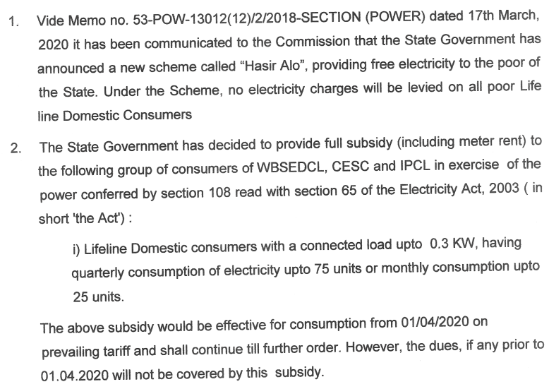
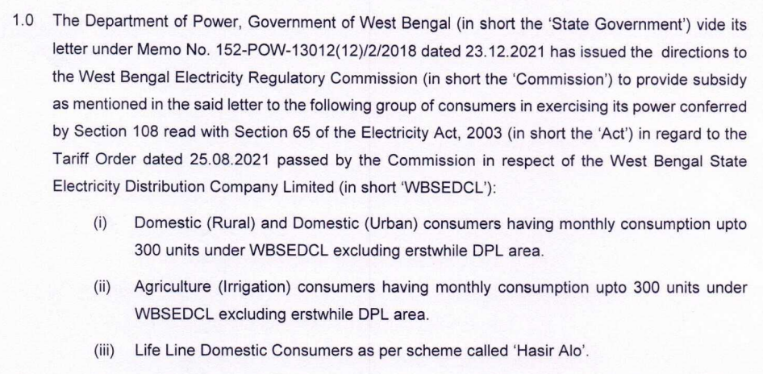
Annexure- 2 (2/2)
Hasir Alo Order: WBERC Order dtd. 31.03.2020 in Case No. A-6/14/G0:
Subsidy Order: WBERC Order dtd. 24.01.2022 in Case No. B-11/23:

Slide 80
Season-wise average hourly load-generation balance (in MW) for WBSEDCL for FY 2018-19

Slide 81
Season-wise average hourly load-generation balance (in MW) for WBSEDCL for FY 2019-20

Slide 82
Season-wise average hourly load-generation balance (in MW) for WBSEDCL for FY 2020-21

Slide 83
Season-wise average hourly load-generation balance (in MW) for WBSEDCL for FY 2021-22

Slide 84
WBPDCL: Historically there has been significant delay in issuance of Tariff/APR/FCA Orders and release of admitted APR/FCA amounts; APR and FCA orders have not been issued from FY 15 onwards
Notional date for Order issuance
Actual Order issuance date
APR/FCA amount release date
Delay (in days)
Tariff Order
Avg. delay in Tariff order issuance: 486 days
Order delay: 463 days (for Sagardighi new units)
Delay in release of admitted amount: 703 days
APR Order
Delay in release of admitted amount: 338 days
APR and FCA Orders for WBPDCL have not been issued from FY 15 onwards
Avg. delay in APR and FCA order issuance: 364 days
FCA Order
Delay in release of admitted amount: 641 days
Delay in release of admitted amount: 549 days
Apr ‘11
Apr ‘12
Apr ‘13
Apr ‘14
Apr ‘15
Apr ‘16
Apr ‘17
Apr ‘18
Apr ‘19
Apr ‘20
Apr ‘21
Apr ‘22
Apr ‘23
Source: WBERC Tariff, APR and FCA Orders for WBPDCL

Slide 85
WBSETCL: Historically there has been significant delay in issuance of Tariff/APR Orders and release of admitted APR amounts; APR orders have not been issued from FY 16 onwards
Notional date for Order issuance
Actual Order issuance date
APR/FPPCA amount release date
Delay (in days)
Tariff Order
Avg. delay in Tariff order issuance: 429 days
APR Orders for WBSETCL have not been issued from FY 16 onwards
Delay in release of admitted amount: 703 days
APR Order
Delay in release of admitted amount: 338 days
Delay in release of admitted amount: 2087 days
Avg. delay in APR order issuance: 1022 days
(amount yet to be released)
Apr ‘11
Apr ‘12
Apr ‘13
Apr ‘14
Apr ‘15
Apr ‘16
Apr ‘17
Apr ‘18
Apr ‘19
Apr ‘20
Apr ‘21
Apr ‘22
Apr ‘23
Source: WBERC Tariff and APR Orders for WBSETCL

Slide 86
WBSEDCL: Historically there has been significant delay in issuance of Tariff/APR/FPPCA Orders and release of admitted APR/FPPCA amounts; APR/FPPCA orders from FY 19 onwards have not been issued
Notional date for Order issuance
Actual Order issuance date
APR/FPPCA amount release date
Tariff Order
Delay (in days)
Avg. delay in Tariff order issuance: 512 days
Delay in release of admitted amount: 3284 days
Delay: 2922 days
Delay: 2554 days
Delay: 2188 days
APR Order
APR and FPPCA Orders from FY 19 onwards have not been issued
Delay: 1823 days
Delay: 1458 days
Delay: 1093 days
Delay in release of admitted amount: 3284 days
Avg. delay in APR and FPPCA order issuance: 1252 days
Delay: 2922 days
Delay: 2554 days
FPPCA Order
Delay: 2188 days
Delay: 1823 days
Delay: 1458 days
Delay: 1093 days
Apr ‘11
Apr ‘12
Apr ‘13
Apr ‘14
Apr ‘15
Apr ‘16
Apr ‘17
Apr ‘18
Apr ‘19
Apr ‘20
Apr ‘21
Apr ‘22
Apr ‘23
Source: WBERC Tariff, APR and FPPCA Orders for WBSEDCL

Slide 87
Domestic L&MV Energy Charge of West Bengal at par with other states

Slide 88
Domestic HV & EHV Energy Charge Comparison
As can be seen from above, Domestic Energy charges for HV and EHV consumers for West Bengal are at par with other states

Slide 89
Tariff Slab complexities witnessed in West Bengal in comparison to other states
1350 kWh
Simpler tariff slabs contribute towards easing up of billing process
1200 kWh
801-1200
1050 kWh
No. of Units
900 kWh
601-900
750 kWh
401-800
600 kWh
301-600
301-500
450 kWh
201-400
300 kWh
201-300
181-300
201-300
201-300
101-300
101-200
103-180
101-200
151-200
0-200
101-200
150 kWh
101-150
51-100
0-102
61-100
61-100
0-100
51-100
26-50
35-60
25-60
0-50
0-25
0-34
0-25
WBSEECL
(Erstwhile DPL)
WBSEECL
IPCL
CESC
MAHADISCOM, Tata Power, ADANI
TPDDL, BSES Rajdhani
BESCOM

Slide 90
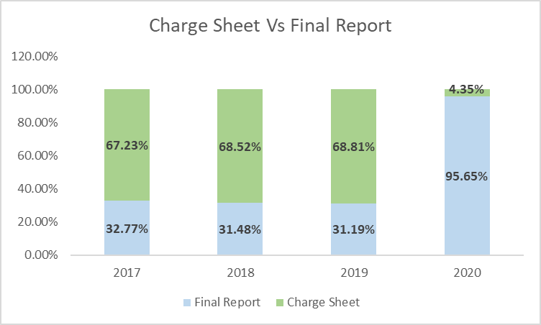
Impact Analysis of anti power theft initiatives in Select States
Anti Power theft police stations play a crucial role in the prevention of power thefts and minimization of AT&C losses.
Power theft initiatives in Gujarat - GUVNL Vigilance Department
24×7 operational control room
Anonymity and Confidentiality maintained; along with provision for online reporting
A cash reward scheme in place
Installation Checking Squads function in each O&M circle in each subsidiary company MGVCL, PGVCL, DGVCL & UGVCL to take appropriate confidential actions on power theft related information.
Periodic pro-active vigilance activities in all subsidiaries of GUVNL
Power theft initiatives in UP
A prompt follow up of the investigations has led to timely resolution of power theft cases with deposition of the compounding penalty and assessed revenues for UPPCL
Improvement in the quality of investigation of power theft crimes in UP
1.Impact Analysis of Anti Power theft police stations
2.GUVNL Vigilance

Slide 91
Delayed release of admitted APR/FCA/FPPCA amounts has resulted in carrying cost burden; Rs. 126.37 Cr (WBSEDCL), Rs. 9.96 Cr (DPL) and Rs. 26.16 Cr (WBSETCL) are yet to be released
Carrying cost for WBPDCL
Carrying cost for WBSEDCL
Order | Admitted Amount (Rs. Cr.) | Delay in release (days) | Carrying Cost (Rs. Cr.)
FY 12 APR | -85.65 | 703 | -
FY 12 APR Review | 2.05 | 3027 | 2.10
FY 12 FCA | 216.65 | 641 | 55.63
FY 13 APR | -45.10 | 338 | -
FY 13 APR Review | 12.64 | 2662 | 12.99
FY 13 FCA | 952.89 | 549 | 208.54
FY 14 APR FCA | 104.76 | 877 | 36.79
Total |  |  | 316.06
Order | Admitted Amount (Rs. Cr.) | Delay in release (days) | Carrying Cost (Rs. Cr.)
FY 12 APR Review | 2.84 | 3284 | 3.60
FY 13 APR + Review | 1,997.31 | 338 – 2922 | 735.64
FY 14 APR | 2,517.03 | 2297 – 2554 | 2,316.73
 | 64.54 | Not yet released | 62.96
FY 15 APR | 92.95 | Not yet released | 76.86
FY 16 & FY 17 APR | 2,359.64 | Not yet released | 1,507.71
FY 18 APR | 509.29 | Not yet released | 203.94
 | 61.83 | Not yet released | 24.83
Total |  |  | 4,932.27
Carrying cost for DPL
Carrying cost for WBSETCL
Order | Admitted Amount (Rs. Cr.) | Delay in release (days) | Carrying Cost (Rs. Cr.)
FY 12 APR | 422.55 | 270 | 45.98
FY 13 APR | 142.83 | 338 | 19.11
FY 14 APR | -0.86 | Not yet released | -
FY 14 APR Review | 10.81 | Not yet released | 10.55
Total |  |  | 75.64
Order | Admitted Amount (Rs. Cr.) | Delay in release (days) | Carrying Cost (Rs. Cr.)
FY 12 APR | 44.71 | 703 | 12.70
FY 13 APR | 5.38 | 338 | 0.73
FY 14 APR | 7.75 | 2087 | 6.25
FY 15 APR | 26.16 | Not yet released | 21.66
Total |  |  | 41.35
Note: Carrying costs have been computed on simple interest basis; SBI PLRs as on the 1st April of the preceding years have been considered as interest rates as per WBERC Tariff Regulations; For unreleased amounts, carrying costs have been computed till 31.03.2022
Source: WBERC Orders

Slide 92
Seasonal Demand and Energy Consumption of WBSEDCL
Seasonal Demand in MW
Seasonal Energy Consumption in MU
2018-19 | 2019-20 | 2020-21 | E 2021-22 | E 2022-23
2018-19 | 2019-20 | 2020-21 | E 2021-22 | E 2022-23
Data Source: ERPC Annual Report and LGBR Report

Slide 93
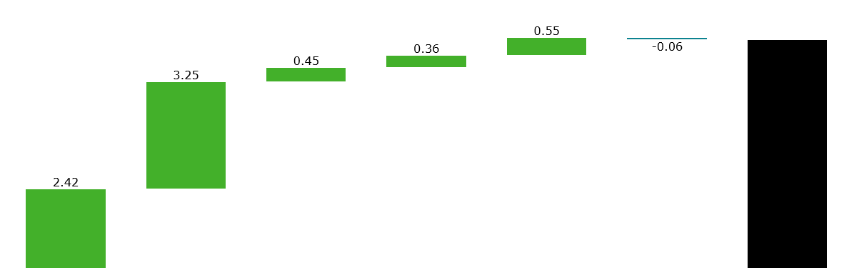
Breakdown of average tariff rate – FY 2020-21 Approved WBERC Order
Rs. 6.97
Part adjustment of APR 2013-14
Revenue per unit from sale of power to licensees and Sikkim
Other fixed cost less non-tariff income
Transmission charges for WBSETCL
Average Tariff Rate
Cost of Power Purchase from Other Sources *
Break up of 2020-21 Average Tariff rate as per tariff order (RS/KWh)
Cost of Power Purchase from WBPDCL
Refer Annexure-I for details of cost of Power Purchase from Other Sources.
N.B.
Average Tariff rate is Rs. 6.97 /KWh considering revenue recoverable from sale of 30923 MUs to own consumers

Slide 94
Sector wise installed capacity (in MW) and category wise revenue rate comparison
Summary of revenue rate including number vs sales for different category of consumers for FY 19-20
Total Installed Capacity of State Sector is 6497.95 MW.
Marginal Renewable share of 2% (122 MW)
Industrial consumer base 0.56% contribute to 32.49% of total energy sales.
Competitiveness of Industrial Tariff of WBSEDCL is critical
HR
Installed Capacity (In MW)
Energy Charge ( Rs/KWh) applicable for Industrial Consumer
* Fixed charge remain same for all three utility and equal to Rs. 384 / KVA/ Month
@ 2020 Deloitte Touche Tohmatsu India LLP

